Slide 1

California Housing
California Housing Dataset : Regression Problem, predictions made for the “median_house_price” using the distance and tree based models.

Slide 2
FE&EDA : Approach
So, for this dataset, there was only one categorical column, and in it, I used the label encoding because of the nature of the feature, apart from that, I applied some calculations for other feature (which can be found in the cleaned file), then afterwards, I applied the scaler to make the copy of the cleaned dataset for the Distance based models, kept the original copy for the tree based models, with minimalistic FE&EDA.
In this file, I used the scaled data for the Tree based models and plain cleaned data for the Distance based models.(swapped the data)

Slide 3
Distance based models

Slide 4

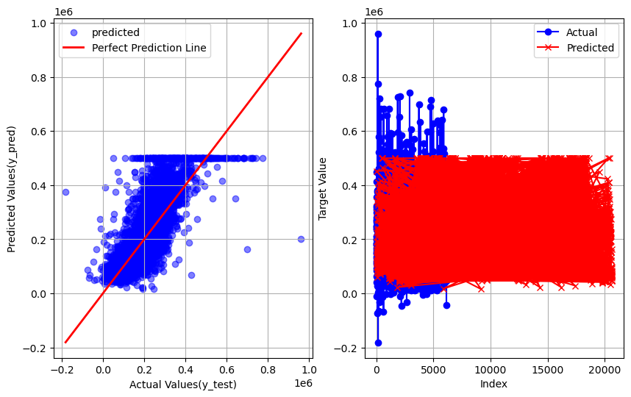
Linear Regression
r2_score : 0.3559360129629727
mean_absolute_error : 52838.02104589945
root_mean_squared_error : 73438.11200979023
mean_squared_error : 5393156295.562497

Slide 5
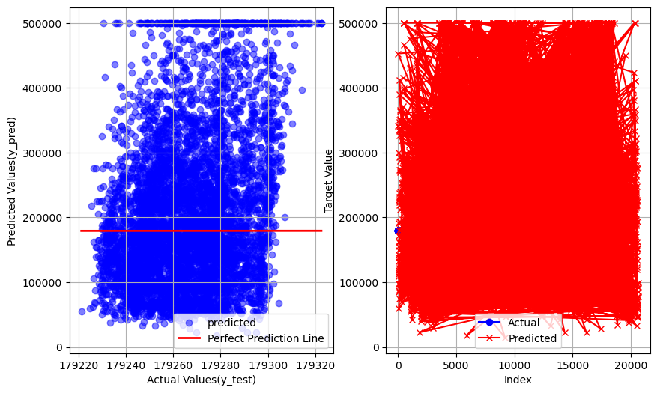
SVR
r2_score : -40314492.86177022
mean_absolute_error : 87929.4670165661
root_mean_squared_error : 117799.26289046017
mean_squared_error : 13876666337.535748

Slide 6
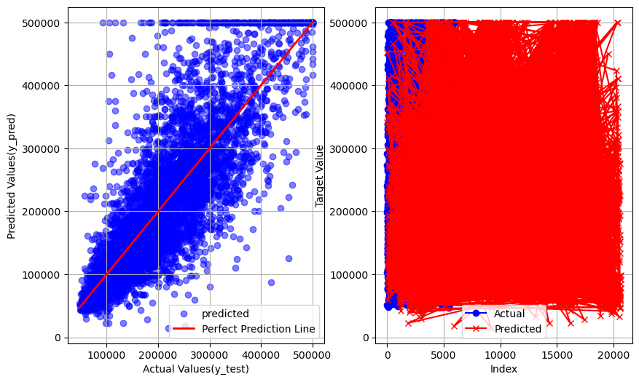
KNN
r2_score : 0.5884149768891674
mean_absolute_error : 42860.51401808785
root_mean_squared_error : 62980.90790809215
mean_squared_error : 3966594760.927584

Slide 7
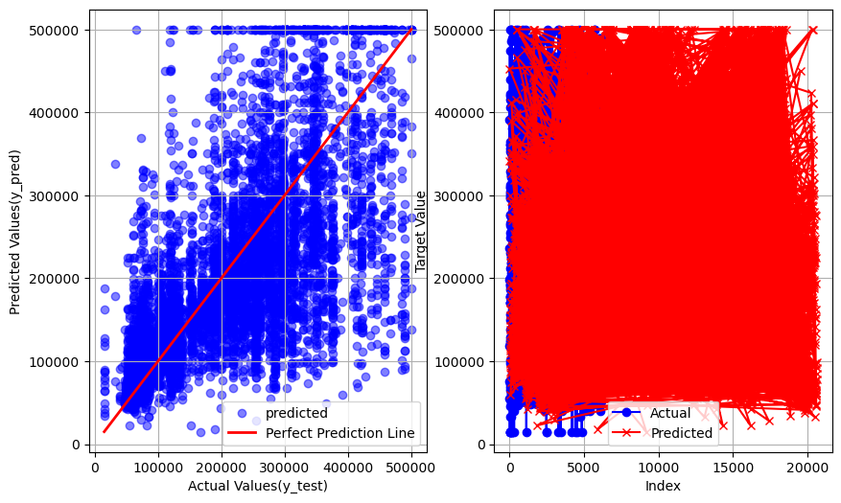
Probability based : Gausian NB
r2_score : 0.26755565067832754
mean_absolute_error : 70636.20655684755
root_mean_squared_error : 98111.27370368899
mean_squared_error : 9625822027.760174

Slide 8
Tree based models

Slide 9
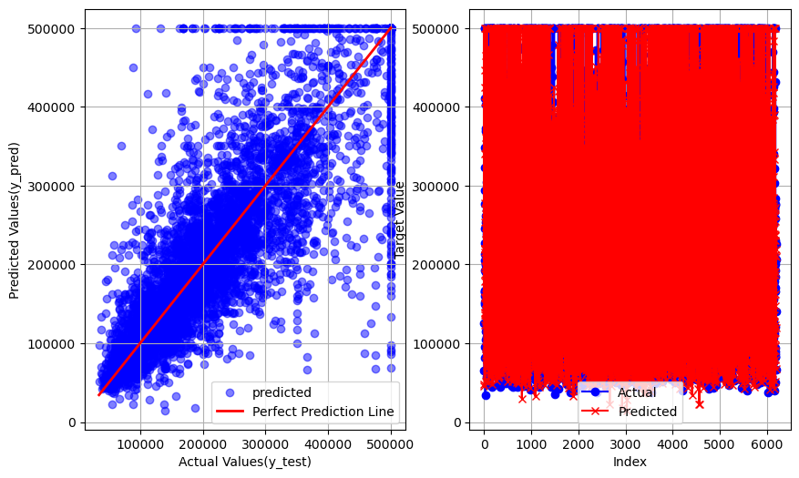
Decision Tree
r2_score : 0.6624676747495832
mean_absolute_error : 41795.68071705427
root_mean_squared_error : 67006.38385146574
mean_squared_error : 4489855476.849968

Slide 10

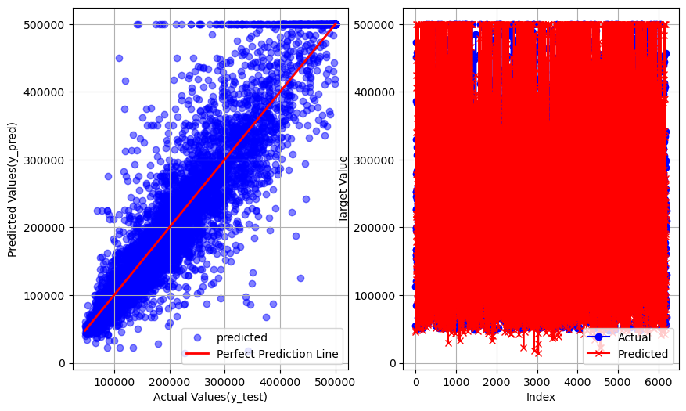
Random Forest
r2_score : 0.7778701710573246
mean_absolute_error : 31377.06202196382
root_mean_squared_error : 48892.42904419067
mean_squared_error : 2390469617.8412194

Slide 11
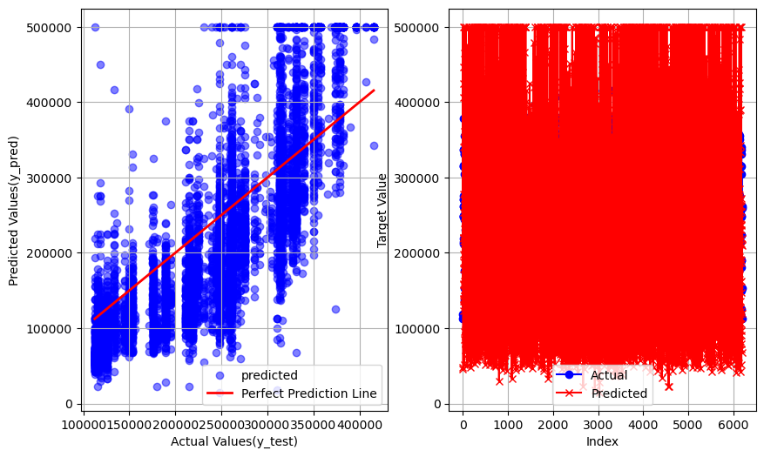
Adaboost
r2_score : -0.03773480590796119
mean_absolute_error : 64637.05874231369
root_mean_squared_error : 77831.1399634673
mean_squared_error : 6057686348.0128355

Slide 12
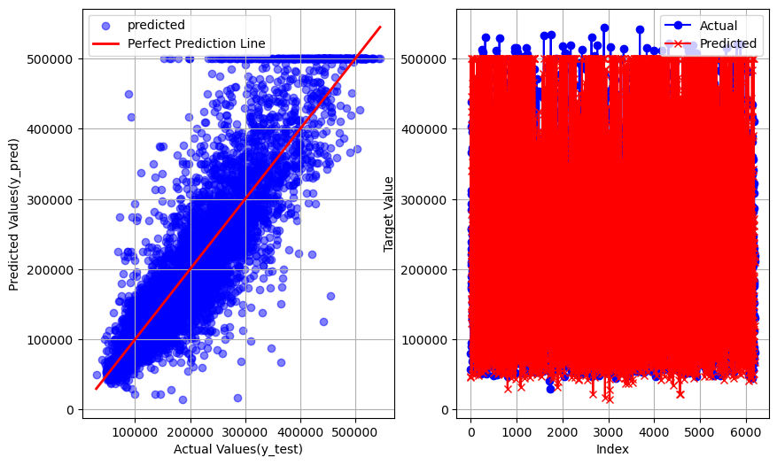
Gradient Boost
r2_score : 0.6990427716661751
mean_absolute_error : 37823.28012990093
root_mean_squared_error : 54641.14118848144
mean_squared_error : 2985654310.379563

Slide 13
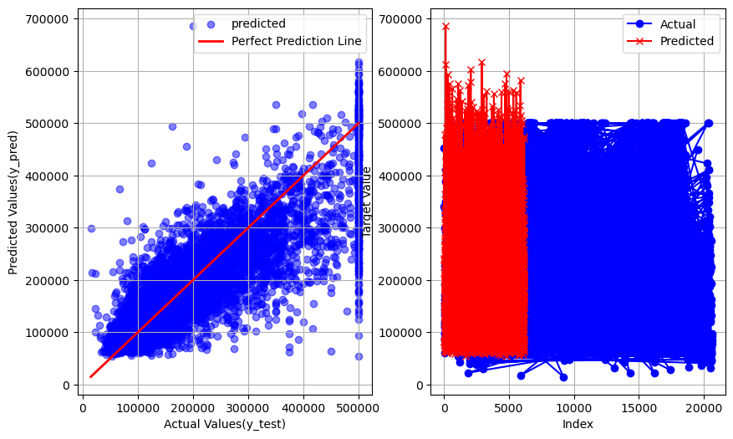
DL : ANN
r2_score : 0.6448958574590412
mean_absolute_error : 47085.24364982033
root_mean_squared_error : 68270.66936363371
mean_squared_error : 4660884295.358595

Slide 14
Thanks for watching.
Made by : Utsav,
Github : utsav87589

